Slide 1
Estimating effort and cost
By Abdulraoof Almasoumi

Slide 2
Outline
What is estimation?
Estimation Methods and techniques
Case Study applications

Slide 3
Estimation
Total costs
Resources - recruitment
Deadline

Slide 4
Costs
Parameters:
Effort costs - Engineers and managers
Software support and hardware maintenance costs
Travel and Training costs
Contingency

Slide 5
Pricing of Product
Affected by costs – contingency with uncertainty
Cost Estimation is crucial
Too high?
Too low?

Slide 6
Estimation Difficulties
Uncertainties:
Unfamiliar platforms
Using new development technology
Unknown staff and skill levels
Huge error margins during starting phases

Slide 7
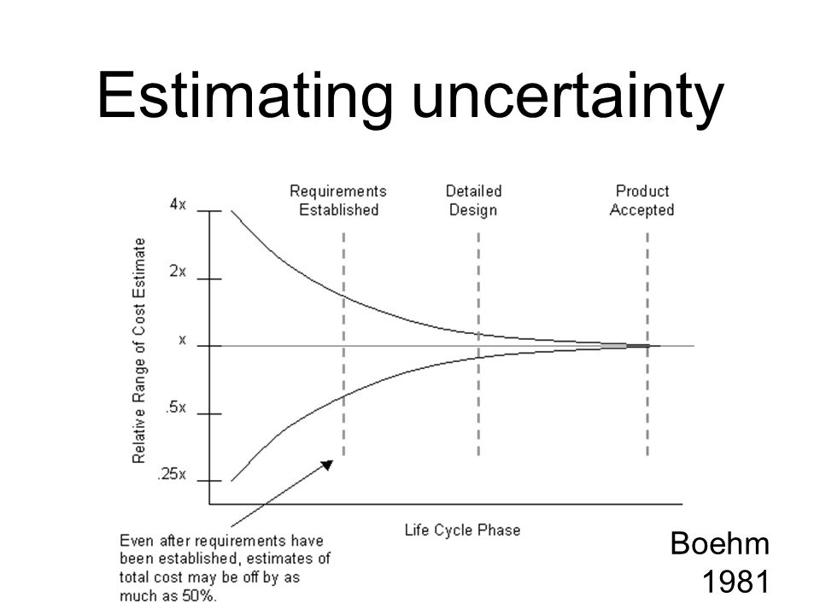

Slide 8
Estimation techniques
Experience based techniques - manager’s informed judgement
Algorithmic modelling techniques

Slide 9
COnstructive COst MOdel II
Application composition model - system development
Early design model – initial effort estimation based on requirements
Reuse model – integrating reused code or automatically generated
Post architecture model - development of system design
Estimation accuracy increases with each stage

Slide 10
Application composition model
Application/ function points
Number of:
Screens and webpages displayed
Reports produced
modules in an imperative programming language – state changers
Scripting languages code

Slide 11
Application composition model
= NAP (1- %reuse/100) / PROD
Number of application points
Reused code
Developer experience level | Very Low | Low | Nominal | High | Very High
PROD (NAP/Month) | 4 | 7 | 13 | 25 | 50

Slide 12

Other stages
Complexity
= A * ${Size}^{B}$ * M
Type of software
Code size
Processing factors
Code size can be in source code lines (SLOC) or function points
Impossible at an early stage
“A” is a constant coefficient: 2.94 in KSLOC

Slide 13
Other stages
M = PERS * PREX * RCPX * RUSE * PDIF * SCED * FSIL
PERS = Personnel capability
PREX = personnel experience
RCPX = product reliability and complexity
RUSE = reuse required code
PDIF = Platform difficulty
SCED = Schedule
FSIL = support facilities
1 “very low” – 6 “very high” point scale:
PERS = 6 means staff is available to work on project fulltime

Slide 14


Other Stages
Complexity “B”
Complexity $∝$ System size
Scale of: 0-5, with 5 being very low
Risk Analysis | Extent to risk analysis carried
Flexibility | Client restrictions
Organizational experience | Experience with type of project
Team cohesion | How well the team know each other
$\frac{Total Ratings}{100} −(1.01$)
Notes:
$$∝$$

Slide 15
Case Study 1 Application
Experience based techniques
Information Systems Development Officer use their experience with IT
Consult groups and get their estimates - revealing factors not considered
Lack of data for Algorithmic modelling

Slide 16
References
Sommerville, Software Engineering, 9th edition, Chapter 23
Stimpson, P., Farquharson, A. and Stimpson, P. (2015) Cambridge international AS and A level business.

